Slide 1
Agile Development

Slide 2
The Manifesto for Agile Software Development
“We are uncovering better ways of developing software by doing it and helping others do it. Through this work we have come to value:
Individuals and interactions over processes and tools
Working software over comprehensive documentation
Customer collaboration over contract negotiation
Responding to change over following a plan
That is, while there is value in the items on the right, we value the items on the left more.”
2
Kent Beck et al (2000)

Slide 3
What is “Agility”?
Effective (rapid and adaptive) response to change
Effective and rapid response to change involves several key strategies that allow individuals or organizations to stay flexible, resilient, and proactive in the face of shifts in their environment, whether those changes are external or internal
3

Slide 4
What is “Agility”?
Effective communication among all stakeholders
Effective communication among all stakeholders is crucial for the success of any project, business initiative, or organizational change. It ensures that everyone is on the same page, working toward common goals, and can respond quickly and effectively to any issues that arise.
4

Slide 5
What is “Agility”?
Drawing the customer onto the team
Drawing the customer onto the team—essentially integrating the customer into the development or decision-making process—is a powerful strategy for improving products, services, and customer satisfaction. When customers are involved, they feel valued, and their insights can lead to a more tailored offering.
5

Slide 6
What is “Agility”?
Organizing a team so that it is in control of the work performed
It is essential for fostering autonomy, improving efficiency, and ensuring accountability. When teams have ownership of their tasks, they are more likely to take initiative, be proactive, and contribute to the success of the project or organization.
Yielding …
Rapid, incremental delivery of software
6

Slide 7
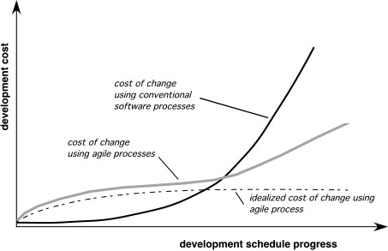
Agility and the Cost of Change
7

Slide 8
An Agile Process
Is driven by customer descriptions of what is required (scenarios)
Recognizes that plans are short-lived
Develops software iteratively with a heavy emphasis on construction activities
Delivers multiple ‘software increments’
Adapts as changes occur
8

Slide 9
Agility Principles - I
1. Our highest priority is to satisfy the customer through early and continuous delivery of valuable software.
2. Welcome changing requirements, even late in development. Agile processes harness change for the customer's competitive advantage.
3. Deliver working software frequently, from a couple of weeks to a couple of months, with a preference to the shorter timescale.
4. Business people and developers must work together daily throughout the project.
5. Build projects around motivated individuals. Give them the environment and support they need, and trust them to get the job done.
6. The most efficient and effective method of conveying information to and within a development team is face–to–face conversation.
9

Slide 10
Agility Principles - II
7. Working software is the primary measure of progress.
8. Agile processes promote sustainable development. The sponsors, developers, and users should be able to maintain a constant pace indefinitely.
9. Continuous attention to technical excellence and good design enhances agility.
10. Simplicity – the art of maximizing the amount of work not done – is essential.
11. The best architectures, requirements, and designs emerge from self–organizing teams.
12. At regular intervals, the team reflects on how to become more effective, then tunes and adjusts its behavior accordingly.
10

Slide 11
Human Factors
The process molds to the needs of the people and team, not the other way around
key traits must exist among the people on an agile team and the team itself:
Competence.
Common focus.
Collaboration.
Decision-making ability.
Fuzzy problem-solving ability.
Mutual trust and respect.
Self-organization.
11

